Slide 1
B. TECH ECE BECE498J - Project - II REVIEW-1
Optimizing 5G Network Performance in Urban Areas Using Machine Learning Techniques
Abhinav Kumar Jha - 21BEC0217
Anubhuti Tewari - 21BEC0607
Mansi Garg - 21BEC2333
Under the guidance of,
Dr. Deepika Rani Sona
Assistant Professor Sr. Grade 1

Slide 2
CONTENT
Introduction
Literature Review
Problem Statement
SDG Goals
Architecture
Analytical and Theoretical Description
Hardware/Software Tools
Expected outcome
Timeline of the project
Summary of Completed Work
Contribution of individual Team members
References

Slide 3
INTRODUCTION
The rapid expansion of 5G networks brings challenges in optimizing resources for efficient, low-latency, and high-speed communication. Traditional methods struggle to meet the growing demands of real-time applications like IoT, autonomous vehicles, and high-bandwidth streaming. This study explores machine learning (ML) techniques, including gradient boosting, LSTM, and neural networks, to enhance signal strength, latency, interference control, and energy efficiency. By training predictive models on real-world data, we develop adaptive algorithms that dynamically optimize network parameters, ensuring improved Quality of Service (QoS) and reliability. Through simulations and experimental analysis, we demonstrate that ML-driven 5G optimization enhances network performance, resilience, and adaptability in evolving digital environments.

Slide 4
CURRENT STATUS AND MOTIVATION
(Literature survey and identifying the gap)
S.No | Paper Name | Published Year | Journal Name | Key Attributes
1. | A Survey of Collaborative Machine Learning Using 5G Vehicular Communications | 2022 | IEEE | This paper provides a comprehensive literature survey on how 5G vehicular communications can enhance machine learning models for autonomous driving
2. | A Comprehensive Survey on Machine Learning Methods for Handover Optimization in 5G Networks | 2024 | IEEE Xplore | This work presents an overview of machine learning methods in handover optimization and discusses various data availability for evaluations..
3. | 5G Traffic Prediction Based on Deep Learning | 2022 | Google Scholar | This paper introduces a smoothed long short-term memory (SLSTM) model for accurate traffic prediction in 5G networks.. . .

Slide 5
S.No | Paper Name | Published Year | Journal Name | Key Attributes
4. | A Survey on Machine Learning-Based Misbehavior Detection Systems for 5G and Beyond Vehicular Networks | 2022 | IEEE Xplore | This survey comprehensively reviews and classifies machine learning-based misbehavior detection systems in vehicular networks.
5. | Internet of Vehicle's Resource Management in 5G Networks Using AI | 2022 | IEEE | This paper discusses resource allocation and management for IoV over 5G RAN networks, focusing on artificial intelligence techniques.
6. | A Vehicular Network-Based Intelligent Transport System for Smart Cities | 2023 | Google Scholar | This research proposes an intelligent transport system for IoV-based vehicular network traffic in a smart city setup..
7. | Machine Learning for QoS Prediction in Vehicular Communication: Challenges and Solution Approaches | 2023 | IEEE Xplore | This paper discusses the challenges and solutions in applying machine learning for quality of service prediction in vehicular communications..

Slide 6
S.N0. | Paper Name | Published Year | Journal Name | Key Attributes
8. | Intelligent Transportation System with 5G Vehicle-to-Everything (V2X): Architectures, Vehicular Use Cases, Emergency Vehicles, Current Challenges, and Future Directions | 2022 | IEEE | The study discusses the research challenges in the field of V2X and presents future directions to reduce the probability of untoward incidents. .
9. | Y.3181: Architectural Framework for Machine Learning in Future Networks Including IMT-2020 | 2022 | IEEE Xplore | This recommendation specifies an architectural framework for integrating machine learning into future networks, including 5G..
10. | A Machine Learning-Based Interest Flooding Attack Detection System in Vehicular Named Data Networking | 2023 | Google Scholar | This work proposes using machine learning to detect interest flooding attacks in vehicular named data networking.

Slide 7
PROBLEM STATEMENT
Challenges in 5G Network Optimization: The increasing complexity of 5G networks makes it difficult to optimize signal strength, bandwidth allocation, latency, interference management, energy efficiency, and traffic load balancing. Traditional network management strategies struggle with dynamic 5G environments, leading to inefficient resource utilization and degraded Quality of Service (QoS) due to user mobility, congestion, and fluctuating traffic demands.
Machine Learning-Based Solution: This study leverages machine learning (ML) techniques such as gradient boosting, LSTM, and neural networks to develop predictive models for real-time 5G network optimization. By analyzing historical and real-time data, ML-driven solutions can proactively enhance signal strength, allocate bandwidth efficiently, reduce latency, mitigate interference, improve energy efficiency, and dynamically balance traffic loads, ensuring seamless connectivity for applications like high-speed data transfer, autonomous vehicles, and IoT.

Slide 8
SDG - SUSTAINABLE DEVELOPMENT GOALS
SDG 7 (Affordable and Clean Energy) – Optimizes energy consumption in 5G networks, reducing power usage and contributing to a more sustainable and energy-efficient telecom infrastructure.
SDG 9 (Industry, Innovation, and Infrastructure) – Enhances connectivity, fosters technological advancements, and strengthens digital infrastructure, enabling smart cities, IoT, and autonomous vehicles.
SDG 11 (Sustainable Cities and Communities) – Supports efficient urban mobility, traffic management, and emergency response systems through reliable, high-speed communication networks.

Slide 9
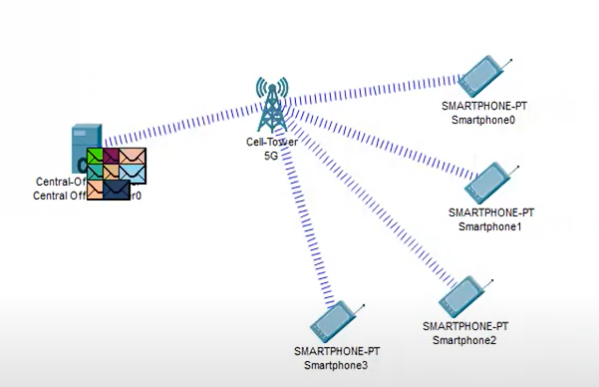
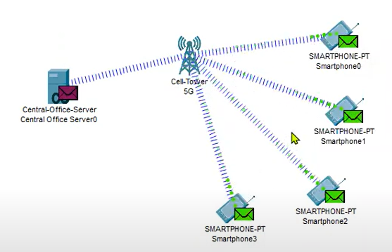
PROPOSED SYSTEM/ARCHITECTURE/DESIGN
The image to the right shows a cell tower connecting multiple smartphones to a central office server. When a Smartphone sends data to the recipient smartphone it goes through a central office server where the server acts as a main processing unit. It is responsible for processing storing and routing the data.
When server processes and routes the data ,it sends the data back to cell tower .The cell tower then in turn sends these information back to recipient smartphones.

Slide 10
ANALYTICAL AND THEORETICAL DESCRIPTION
Overview of 5G Machine Learning Optimization
Background: Advanced resource management techniques are needed in 5G networks due to the growing demand for dependable, fast, and low-latency communication.
Challenges: Dynamic network conditions, user mobility, interference, and energy inefficiency are issues that traditional techniques face.
Solution: Predictive and adaptive solutions for traffic balancing, latency reduction, bandwidth allocation, and signal strength optimization are offered by machine learning (ML).
Goal: Create ML-powered resource optimization strategies that improve network flexibility, dependability, and efficiency.

Slide 11
MODEL ALGORITHM
Step 1: Start
Step 2: Data Preprocessing
Load the dataset.
Clean and preprocess the data (handle missing values, normalize, etc.).
Step 3: Data Splitting and Model Training
Split the dataset into training (80%) and testing (20%).
Train the following models:
  Gradient Booster Regression → for signal strength prediction.
  LSTM (TensorFlow-based) → for user mobility prediction.
  Random Forest → for interference prediction.
Step 4: Model Evaluation and Optimization
Evaluate model performance using appropriate metrics (e.g., RMSE, accuracy, etc.).
Tune hyperparameters for better efficiency and accuracy.
Step 5: Results Interpretation
Derive key parameters from model predictions.
Visualize the results using graphs and performance metrics.
Step 6: Stop

Slide 12
THEORETICAL STRUCTURE AND ESSENTIAL MACHINE LEARNING METHODS
Theoretical Foundation:
* 5G networks require intelligent decision-making due to their complicated, real-time data processing.
* To maximize network performance, machine learning models learn from both historical and current data.
Important ML Methods Employed:
* Gradient Boosting Regressor: Forecasts changes in signal strength.
* Latency behavior is modeled by linear regression.
Long Short-Term Memory (LSTM):
* Predicts network congestion and user mobility.
* The Random Forest Classifier finds patterns of interference.
Neural Networks:
* Dynamically optimize the distribution of resources.

Slide 13
ANALYTICAL MODEL: PERFORMANCE METRICS AND DATA PROCESSING
Steps in Data Processing:
* Preprocessing includes feature scaling, categorical variable encoding, and handling missing values.
* Training and Testing: To validate the model, the dataset is divided into 80% training and 20% testing.
Metrics for Evaluation:
* The accuracy of predictions is measured by the Mean Squared Error (MSE).
* Model dependability is determined by the R-squared score.
* Confusion Matrix & Accuracy Score: Assesses performance in classification.
Indicators of Model Performance:
* Enhanced forecasting of signal strength.
* Decreased variations in latency.
* Improved energy efficiency and bandwidth utilization.

Slide 14
RESULTS AND OBSERVATIONS OF THE EXPERIMENT
Important Findings:
*Signal Strength Prediction: LSTM with Gradient Boosting led to a considerable reduction in MSE.
*Optimization of Energy Efficiency: Gradient Booster regression reduced errors by 15–25%.
Random Forest offered 85–90% classification accuracy for interference detection.
Energy Efficiency:
*Power consumption was reduced by ML-based optimization.
In summary:
* ML greatly improves the optimization of 5G networks.
* Future research will focus on self-learning network models, edge computing integration, and real-time deployment.

Slide 15
HARDWARE/SOFTWARE TOOLS AND SIMULATION/DESIGN PARAMETERS
Python version 3.12
Cisco Packet Tracer version 8.2.2

Slide 16
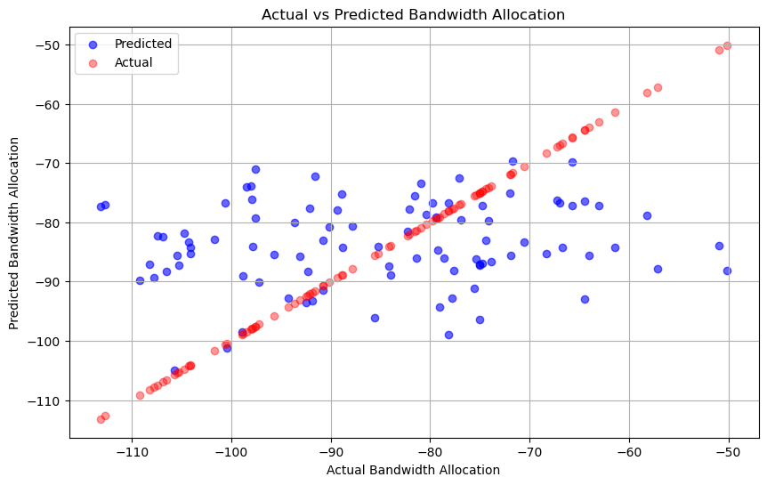
EXPECTED OUTCOME
Resource Allocation Optimization (Bandwidth Allocation)
The Graph shown below compares the real bandwidth allocation vs bandwidth predicted by our machine learning model. The machine learning model used in this is a gradient-based regression model. This is very important as this explains if our model is working fine or not. If values predicted by the model are close to actual values this suggests that the model is working fine. This helps to distribute bandwidth properly.

Slide 17
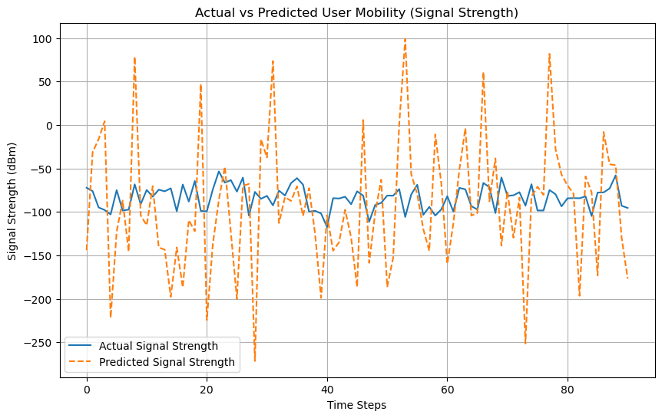
2. User Mobility Prediction
The Graph given below shows a signal strength comparison of moving users. This Graph is a real vs predicted signal strength graph. The model used is a long short-term memory-based module (LSTM). LSTM is a type of recurrent neural network that is used to capture time-dependent variations in signal strength as users move. It helps in predicting network coverage issues as users move. It helps adjust signal power for better connectivity.

Slide 18
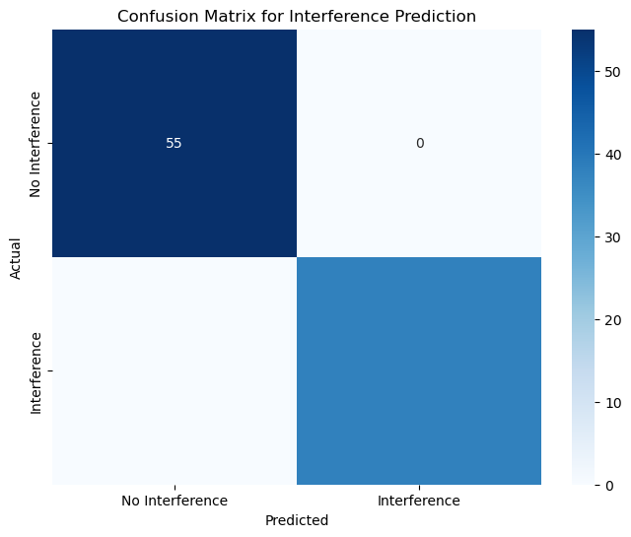
3. Interference Management
The figure given below is the network inference detection matrix. The Model used is a random forest classifier. This is important for classifying signal inferences and weak areas. It helps to improve network stability and call quality. It is a confusion matrix for estimating if the model achieved its goal of detecting network interference. The predicted values have been divided into true positives (TP), when interference is appropriately classified, and true negatives (TN) when it is not identified and should not be expected or predicted, and false positives (FP), where interference should have been predicted, and false negatives (FN) when the interference is ignored in interference measurement.

Slide 19
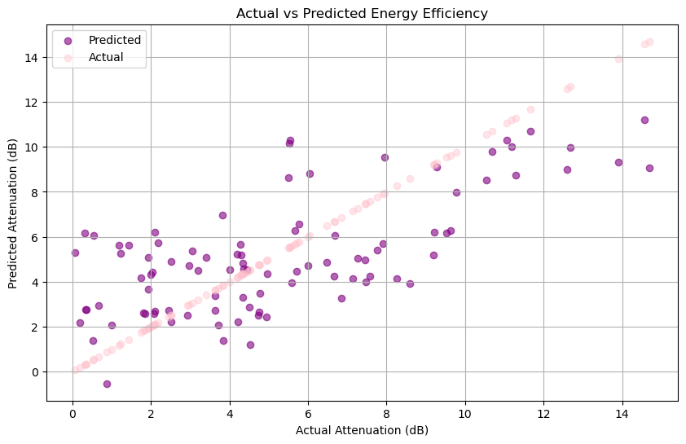
4. Energy Efficiency
The graph below shows a comparison between predicted and actual energy efficiency values in a 5G network optimization study. The machine learning model used in this is gradient-based regression model. The x-axis values indicate the predicted values for the process while the y-axis is indicative of actual loss values in decibel form. Both the axes extend from 0 to 14, thereby indicating the measurement scale for energy efficiency. Such comparisons will be very important in assessing the model's accuracy in optimizing energy consumption, easing the network's service quality while conserving power. The proximity of predicted and actual values would establish the model’s effectiveness in enhancing energy efficiency..

Slide 20
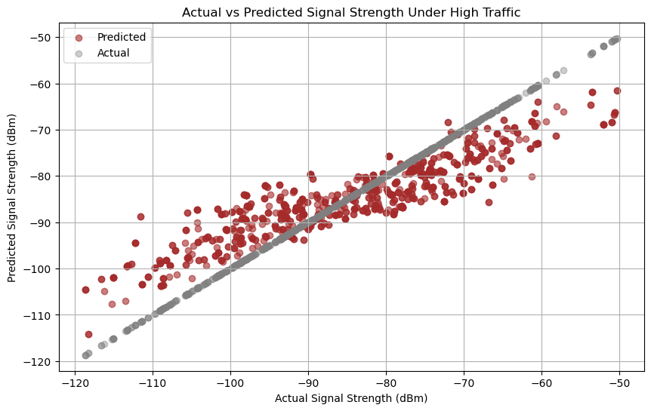
5. Scalability and Performance Under Load
The graph shown below is actual vs predicted signal strength under high-traffic areas. The machine learning model used for this is the gradient-based regression model. The graph below ensures strong signal strength even in crowded areas. The x-axis represents predicted signal strength, with ranges from -50 dBm to -120 dBm, while the y-axis depicts actual signal strength in dBm. This comparison is essential for evaluating the level of performance of the machine-learned model to suggest that it provides strong signal strength in congested areas. This graph appears that it demonstrate how well the model would predict signal strength during difficult conditions, assuring reliable connectivity and optimal network performance during peak usage. The closer the values of prediction and actual values, the better it interprets the effectiveness of the model in a high-traffic situation.

Slide 21
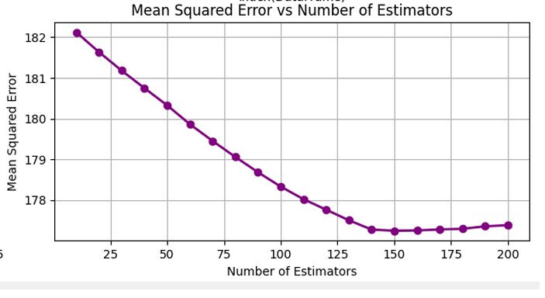
6. Impact of Estimators on Mean Squared Error
The graph given below captures the relation between mean squared error (MSE) and the number of estimators in a machine learning model. The x-axis gives the number of estimators, which are parts of an ensemble method such as gradient boosting or random forests and the mean squared error on the y-axis indicates the ability of the model to make predictions lower means good performance. This graph is beneficial to note the trend in the error rate for a model with the increase of the number of estimators and helps in identifying the optimum number of estimators that will minimize MSE so that the model's predictive accuracy and efficiency can be enhanced.

Slide 22
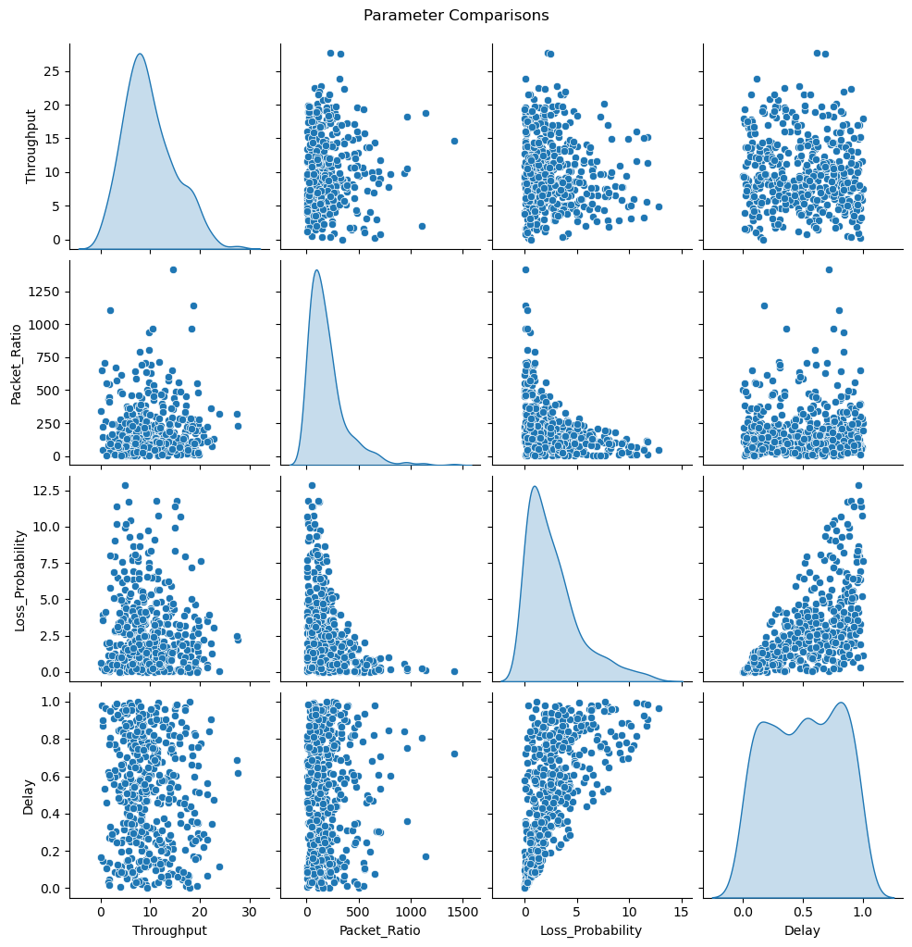
7. Comparison Graphs for Throughput, Packet Ratio, Loss Probability, and Delay
The graph is a pair plot (scatter matrix) used for comparing multiple network performance parameters: Throughput, Packet Ratio, Loss Probability, and Delay. Each diagonal plot represents the distribution of a single parameter, while the off-diagonal scatter plots show the relationships between different parameters. The Throughput distribution appears right-skewed, indicating most values are on the lower end. Packet Ratio vs. Loss Probability shows an inverse relationship, suggesting higher packet ratios tend to result in lower loss probabilities. Delay vs. Loss Probability exhibits a positive correlation, indicating higher loss probabilities lead to increased delays. The scatter plots highlight potential trends, dependencies, and variations among these key network performance metrics, aiding in the analysis of 5G network efficiency.

Slide 23
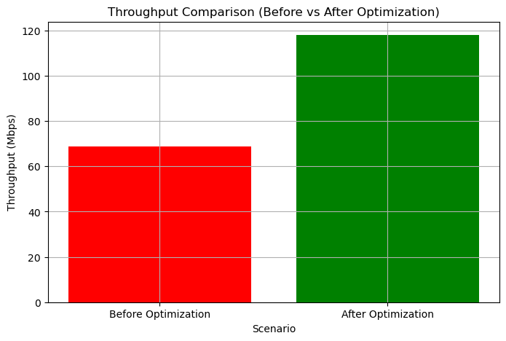
8. Throughput Comparison
Before ML deployment, 5G network throughput was strongly unpredictable because bandwidth was not allocated efficiently and the network was congested. Data transmission rates fluctuated, impacting real-time communications such as video streaming and IoT. Nevertheless, following ML optimization, the system can control bandwidth and traffic distribution dynamically to have higher and more stable throughput. Through network demand prediction and on-the-fly resource adjustment, ML-based models optimize data transmission efficiency, avoid congestion, and ensure constant information flow. This optimization is invaluable for applications that involve low latency and fast communication, providing a better user experience overall.

Slide 24
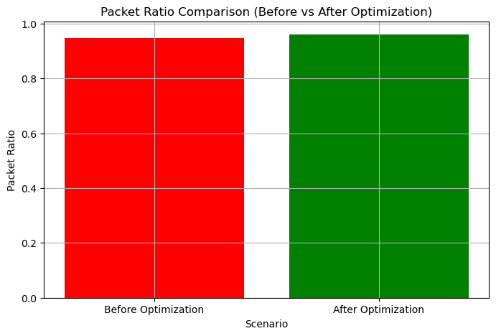
9. Packet Ratio Comparison
Packet Delivery Ratio (PDR) is an important metric that calculates the ratio of successfully delivered packets. Before ML optimization, PDR was comparatively low because there was constant network congestion, inefficient routing, and unforeseen interference. Most packets were lost in transit, and communication quality was poor. With ML-based optimization, smart traffic management and routing algorithms guarantee packets are delivered more effectively. Traffic flow is predicted, network resources are optimized, and routing paths are dynamically reconfigured to reduce packet drops by ML models. Thus, PDR has increased significantly, with data transmission guaranteed reliably, a feature critical for high-speed mobile use and real-time communication services.

Slide 25
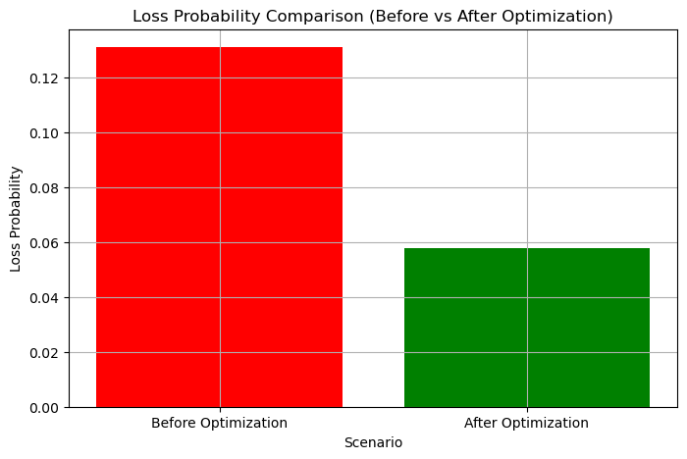
10. Loss Probability Comparison
Loss Probability can be defined as the basic fraction of packets that are lost in transmission. About the scenario, before optimization, the loss probability was too high, mainly due to network congestion further compounded by routing mechanisms that did not seem to bring stability and unpredictable interference conditions. This resulted in communications that were not very usable, hence affecting overall network efficiency. After optimization, though, advanced techniques in intelligent traffic management and dynamic routing contributed to a sharp decline in packet-loss statistics. Therefore, the optimization process ensured data packet delivery with high reliability, implying overall stability and improved performance at the network level.

Slide 26
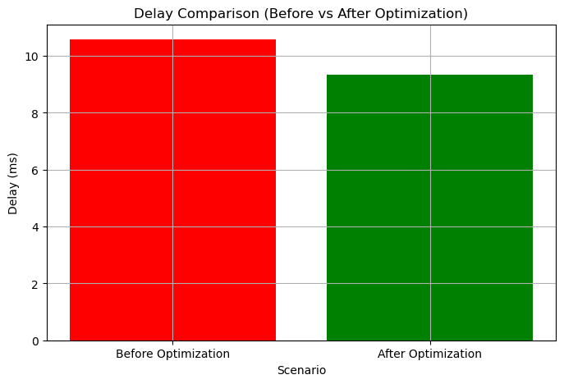
11. Delay Comparison
As delay serves as a key performance indicator, it reveals the time taken for the data packets to move from the source to the destination. The network before optimization suffered from a high delay due to route path congestion coupled with poor resource allocation, which made real-time communication extremely challenging. Instead of the previously set boundaries, the optimized network was able to get rid of superfluous delays through effective scheduling and load balancing. This increased the effectiveness and efficacy of data transfer, making the network more suited for numerous applications that require real-time feedback, such as mobile communication networks and disaster communication networks.

Slide 27
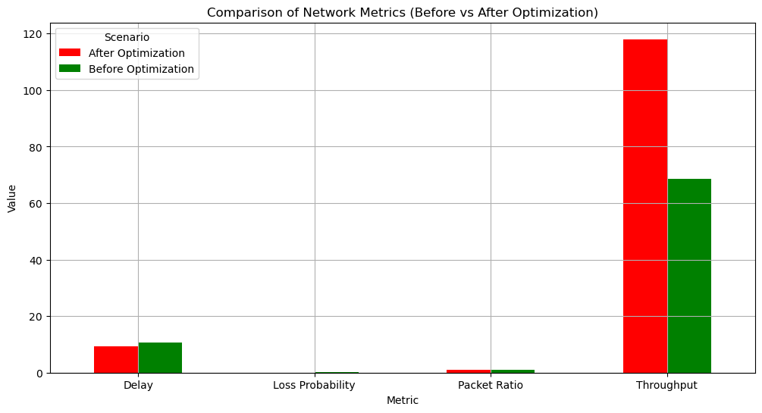
The bar chart compares network performance metrics before and after optimization, highlighting improvements in key parameters. The green bars represent values before optimization, while the red bars indicate values after optimization. The throughput has significantly increased after optimization, indicating improved network efficiency. Delay, loss probability, and packet ratio have all decreased, suggesting reduced congestion, better bandwidth allocation, and lower interference. These optimizations likely result from machine learning-driven resource management, leading to enhanced Quality of Service (QoS) and overall network performance.

Slide 28
TIMELINE OF THE PROJECT
The project has a planned schedule that starts with
Research & Problem Definition (Month 1-2) when goals are established and difficulties in 5G network optimization are noted.
Data Collection & Preprocessing (Month 2-3) gathers, cleans, and engineers pertinent datasets for model training. ML models like Random Forest, LSTM, and Gradient Boosting are implemented and assessed during
Optimization & Performance Tuning (Months 3-4 ) follow, during which hyperparameters are changed to increase accuracy. The goal of
Results Analysis & Visualization (Month 4-5) to use graphs and insights to interpret model outcomes. The findings are finally compiled, the project report is prepared, and the final presentation will be prepared.

Slide 29
SUMMARY OF COMPLETED WORK AND WORK YET TO BE CARRIED OUT
With an emphasis on forecasting signal strength, cutting latency, identifying interference, and improving resource allocation, the project has effectively applied and assessed several machine learning algorithms, including Random Forest, LSTM, and Gradient Boosting, to optimize 5G network performance. Improvements in network efficiency have been shown through feature engineering and model evaluation utilizing metrics including accuracy, R2 score, and MSE.
Nevertheless, further work needs to be done to improve the models for real-time deployment, incorporate more datasets for increased accuracy, and run extensive simulations to verify performance in dynamic network situations.

Slide 30
CONTRIBUTION OF INDIVIDUAL TEAM MEMBERS
Abhinav Kumar Jha (21BEC0217) - Data Handling and Implementation of Linear Regression Model
Anubhuti Tewari (21BEC0607) - LSTM model Implementation and Key Parameter Analysis
Mansi Garg (21BEC2333) - Random Forest Model Implementation and visualization of the key parameter
.

Slide 31
REFERENCES
[1] Salvador V. Balkus, Honggang Wang -.A Survey of Collaborative Machine Learning Using 5G Vehicular Communications
[2] Senthil Kumar Thillaigovindhan, Mardeni Roslee - A Comprehensive Survey on Machine Learning Methods for Handover Optimization in 5G Networks.
[3] Gao- 5G Traffic Prediction Based on Deep Learning
[4] Abdelwahab Boualouache, Thomas Engel - A Survey on Machine Learning-Based Misbehavior Detection Systems for 5G and Beyond Vehicular Networks.
[5] Ikechukwu Harrison Ezeh - Internet of Vehicle's Resource Management in 5G Networks Using AI
[6] T. V. RAGHU , (Student Member, IEEE), AND M. KIRAN , (Member, IEEE) A Vehicular Network-Based Intelligent Transport System for Smart Cities
[7] Alexandros Palaios, Christian L. Vielhaus - Machine Learning for QoS Prediction in Vehicular Communication: Challenges and Solution Approaches.
[8] Tejal Rathod, Sudeep Intelligent Transportation System with 5G Vehicle-to-Everything (V2X): Architectures, Vehicular Use Cases, Emergency Vehicles, Current Challenges, and Future Directions

Slide 32
[9] Magsi, A.H., Mohsan, S.A.H.- A Machine Learning-Based Interest Flooding Attack Detection System in Vehicular Named Data Networking
[10] Lithungo K. Murry - Deep Reinforcement Learning for Autonomous Driving: A Survey
[11] R. Hussain and S. Zeadally – Autonomous cars: Research results, issues, and future challenges," IEEE Communications Surveys & Tutorials
[12] R. Lu, L. Zhang, J. Ni, and Y. Fang – 5G vehicle-to-everything services: Gearing up for security and privacy.
[13] X. Duan, Y. Liu, and X. Wang – SDN enabled 5G-VANET: Adaptive vehicle clustering and beamformed transmission for aggregated traffic
[14] L. Li, K. Ota, and M. Dong – Humanlike driving: Empirical decision-making system for autonomous vehicles.
[15] H. Khelifi et al. – Named data networking in vehicular ad hoc networks: State-of-the-art and challenges.
[16] Z. He, J. Cao, and X. Liu – SDVN: Enabling rapid network innovation for heterogeneous vehicular communication.

